Slide 1
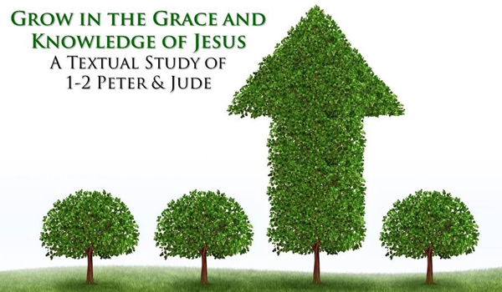
Growing As Children of Light
Notes:
This graphic came from Jason Hardin. I am certain have I have used notes from Mark Copeland’s EO series, Randy Yerby, Aaron Fleenor and other in making these powerpoints. Further, images have been used from the internet that remain property of their owners. This can not be sold or used commercially. It can only be used for classroom (Bible class) purposes.

Slide 2
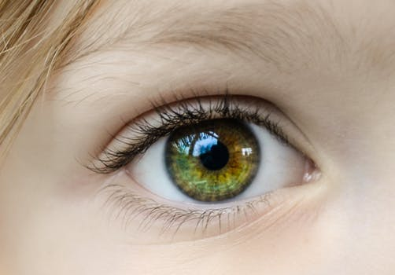
Eyeing Second Peter
Week 12: In the Twinkling of an Eye: The Lord’s Return – Chapter 3

Slide 3

Eyeing Second Peter
Weekly study plan:
Read 2 Peter once a week
Work on the memory verse by reading it carefully aloud at least eleven times this week
Any study on next weeks topic in the text from next week’s topic: Partaking of the Divine Nature

Slide 4
Memory Passage: 2 Peter 1:3-4
According as his divine power hath given unto us all things that pertain unto life and godliness,
through the knowledge of him that hath called us to glory and virtue:
Whereby are given unto us exceeding great and precious promises:
that by these ye might be partakers of the divine nature,
having escaped the corruption that is in the world through lust.

Slide 5
Remembering Second Peter
Blindness and Myopia Control
Eyes Full of Adultery
Twinkling of an Eye
Holiness – Heresy – Hope
Cultivate Christian Character
Condemnation of false teachers
Confidence in Christ’s return
Read 10X, 10 Classes, Mechanism, Memory verse

Slide 6
2 Peter 3:1-8 This second epistle, beloved, I now write unto you; in both which I stir up your pure minds by way of remembrance: That ye may be mindful of the words which were spoken before by the holy prophets, and of the commandment of us the apostles of the Lord and Saviour: Knowing this first, that there shall come in the last days scoffers, walking after their own lusts, 4 And saying, Where is the promise of his coming? for since the fathers fell asleep, all things continue as they were from the beginning of the creation. 5 For this they willingly are ignorant of, that by the word of God the heavens were of old, and the earth standing out of the water and in the water: 6 Whereby the world that then was, being overflowed with water, perished: 7 But the heavens and the earth, which are now, by the same word are kept in store, reserved unto fire against the day of judgment and perdition of ungodly men. 8 But, beloved, be not ignorant of this one thing, that one day is with the Lord as a thousand years, and a thousand years as one day.

Slide 7
2 Peter 3:9-12 The Lord is not slack concerning his promise, as some men count slackness; but is longsuffering to us-ward, not willing that any should perish, but that all should come to repentance. 10 But the day of the Lord will come as a thief in the night; in the which the heavens shall pass away with a great noise, and the elements shall melt with fervent heat, the earth also and the works that are therein shall be burned up. 11 Seeing then that all these things shall be dissolved, what manner of persons ought ye to be in all holy conversation and godliness,12 Looking for and hasting unto the coming of the day of God, wherein the heavens being on fire shall be dissolved, and the elements shall melt with fervent heat?

Slide 8
1 Corinthians 15:48-53 As is the earthy, such are they also that are earthy: and as is the heavenly, such are they also that are heavenly. 49 And as we have borne the image of the earthy, we shall also bear the image of the heavenly. 50 Now this I say, brethren, that flesh and blood cannot inherit the kingdom of God; neither doth corruption inherit incorruption. 51 Behold, I shew you a mystery; We shall not all sleep, but we shall all be changed, 52 In a moment, in the twinkling of an eye, at the last trump: for the trumpet shall sound, and the dead shall be raised incorruptible, and we shall be changed. 53 For this corruptible must put on incorruption, and this mortal must put on immortality. 54 So when this corruptible shall have put on incorruption, and this mortal shall have put on immortality, then shall be brought to pass the saying that is written, Death is swallowed up in victory.

Slide 9
1 Thessalonians 4:13-18 But I would not have you to be ignorant, brethren, concerning them which are asleep, that ye sorrow not, even as others which have no hope. 14 For if we believe that Jesus died and rose again, even so them also which sleep in Jesus will God bring with him. 15 For this we say unto you by the word of the Lord, that we which are alive and remain unto the coming of the Lord shall not prevent them which are asleep. 16 For the Lord himself shall descend from heaven with a shout, with the voice of the archangel, and with the trump of God: and the dead in Christ shall rise first: 17 Then we which are alive and remain shall be caught up together with them in the clouds, to meet the Lord in the air: and so shall we ever be with the Lord. 18 Wherefore comfort one another with these words.

Slide 10
John 11:25-26 Jesus said unto her, I am the resurrection, and the life: he that believeth in me, though he were dead, yet shall he live: 26 And whosoever liveth and believeth in me shall never die. Believest thou this?

Slide 11
2 Thessalonians 1:6-10 Seeing it is a righteous thing with God to recompense tribulation to them that trouble you;7 And to you who are troubled rest with us, when the Lord Jesus shall be revealed from heaven with his mighty angels,8 In flaming fire taking vengeance on them that know not God, and that obey not the gospel of our Lord Jesus Christ:9 Who shall be punished with everlasting destruction from the presence of the Lord, and from the glory of his power;10 When he shall come to be glorified in his saints, and to be admired in all them that believe (because our testimony among you was believed) in that day.

Slide 12
Mark 13:32-37 But of that day and that hour knoweth no man, no, not the angels which are in heaven, neither the Son, but the Father. 33 Take ye heed, watch and pray: for ye know not when the time is. 34 For the Son of man is as a man taking a far journey, who left his house, and gave authority to his servants, and to every man his work, and commanded the porter to watch. 35 Watch ye therefore: for ye know not when the master of the house cometh, at even, or at midnight, or at the cockcrowing, or in the morning: 36 Lest coming suddenly he find you sleeping. 37 And what I say unto you I say unto all, Watch.

Slide 13
Luke 17:26-36 And as it was in the days of Noe, so shall it be also in the days of the Son of man. 27 They did eat, they drank, they married wives, they were given in marriage, until the day that Noe entered into the ark, and the flood came, and destroyed them all. 28 Likewise also as it was in the days of Lot; they did eat, they drank, they bought, they sold, they planted, they builded; 29 But the same day that Lot went out of Sodom it rained fire and brimstone from heaven, and destroyed them all. 30 Even thus shall it be in the day when the Son of man is revealed. 31 In that day, he which shall be upon the housetop, and his stuff in the house, let him not come down to take it away: and he that is in the field, let him likewise not return back. 32 Remember Lot's wife. 33 Whosoever shall seek to save his life shall lose it; and whosoever shall lose his life shall preserve it. 34 I tell you, in that night there shall be two men in one bed; the one shall be taken, and the other shall be left. 35 Two women shall be grinding together; the one shall be taken, and the other left. 36 Two men shall be in the field; the one shall be taken, and the other left.

Slide 14
Matthew 16:27-28 For the Son of man shall come in the glory of his Father with his angels; and then he shall reward every man according to his works. 28 Verily I say unto you, There be some standing here, which shall not taste of death, till they see the Son of man coming in his kingdom.
Romans 13:11-12 that, knowing the time, that now it is high time to awake out of sleep: for now is our salvation nearer than when we believed. 12 The night is far spent, the day is at hand: let us therefore cast off the works of darkness, and let us put on the armour of light.

Slide 15
James 5:7-10 Be patient therefore, brethren, unto the coming of the Lord. Behold, the husbandman waiteth for the precious fruit of the earth, and hath long patience for it, until he receive the early and latter rain. 8 Be ye also patient; stablish your hearts: for the coming of the Lord draweth nigh. 9 Grudge not one against another, brethren, lest ye be condemned: behold, the judge standeth before the door. 10 Take, my brethren, the prophets, who have spoken in the name of the Lord, for an example of suffering affliction, and of patience.

Slide 16
1 Peter 4:5-7 Who shall give account to him that is ready to judge the quick and the dead. 6 For for this cause was the gospel preached also to them that are dead, that they might be judged according to men in the flesh, but live according to God in the spirit. 7 But the end of all things is at hand: be ye therefore sober, and watch unto prayer.

Slide 17

Introduction
The word atomos is a Greek word which has reference to the smallest entity imaginable and is the root or source for the word atom.
When the atom was first named, it was thought to be the smallest particle of matter that is indivisible.
Atomos is the word we translate “in the twinkling of an eye.”
Just how fast is the twinkling of an eye? The results and opinions varied in the research encountered. Any way one might consider, “the twinkling of an eye” is extremely fast.

Slide 18
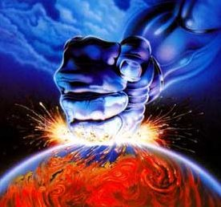
Introduction
Considering how quick an actual twinkling is, we can see it has significant implications relative to our transformation at Jesus’ return.
In 1 Corinthians 15:50-58, Paul speaks of Jesus’ return and our transformation happening in the twinkling of an eye.
There will be no time for repentance, prayer or baptism.
There will be no time to prepare ourselves.
In that fraction of a second, the dead will rise, and the living will be changed from mortal to immortal.

Slide 19
Introduction
In that same instant, 2 Thessalonians 1:6-10 indicates Jesus will be revealed from heaven with His mighty angels in flaming fire.
They will be taking vengeance on those who do not know God and do not obey the gospel of Jesus. Think about what was said.
The people subject to this punishment are not just those we might think of as evil or devoid of any knowledge of God.
Those who do not obey the gospel are also in peril.
That group includes those who reject the gospel altogether and those who have received the gospel message but decided not to obey.
Those who obeyed but are not fully obedient to the gospel of Jesus are also included.
1 Peter 4:17 warns us that judgment will begin with the house of God, which is the church.

Slide 20
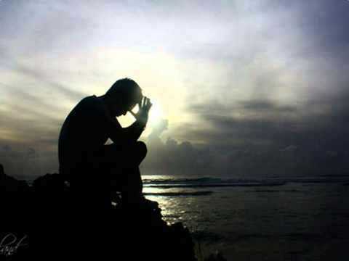
Introduction
What should we do?
Mark 13:33 tells us to watch in patience and pray because we do not know when the day of the Lord will come.
Verse 32 indicates no one knows when that day will come.
Not the angels or even Jesus Himself know.
Only God the Father knows the day and hour.
He will come as a thief in the night for those who are not prepared.
There will be no time to be reconciled to God when Jesus returns.

Slide 21
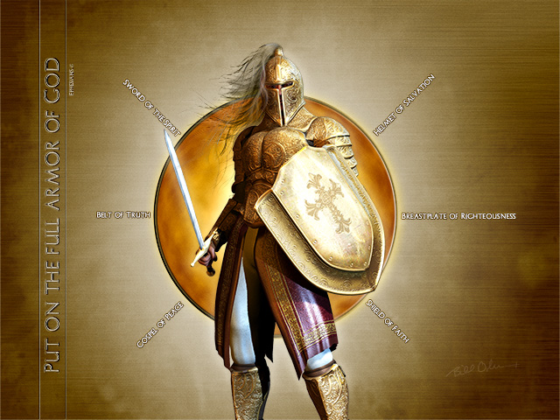
Deliverance from God Wrath
God wants us to be called from the darkness into His light.
Romans 13:11-12 instructs, "that, knowing the time, that now it is high time to awake out of sleep: for now is our salvation nearer than when we believed. The night is far spent, the day is at hand: let us therefore cast off the works of darkness, and let us put on the armour of light."
Paul calls it our “armour” as we are in a spiritual battle for souls.
The breastplate of righteous, faith and love, the sword of faith, and the helmet of salvation are part of that armor (1 Thes 5:8; Eph 6:13-17) as we battle in a spiritual war.
These weapons are mighty and powerful to bring every thought in obedience to God (2 Cor 10:3-5).

Slide 22
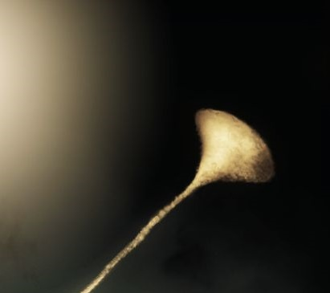
Deliverance from God Wrath
We must wait for Christ while living for God.
1 Thessalonians 1:10 teaches, "And to wait for his Son from heaven, whom he raised from the dead, even Jesus, which delivered us from the wrath to come."
Thus, we are called into the light of the day to live lives knowing that we will avoid the wrath of God and obtain salvation in the Christ.
1 Thessalonians 5:8-10 explains: "For they that sleep sleep in the night; and they that be drunken are drunken in the night. But let us, who are of the day, be sober, putting on the breastplate of faith and love; and for an helmet, the hope of salvation. For God hath not appointed us to wrath, but to obtain salvation by our Lord Jesus Christ, Who died for us, that, whether we wake or sleep, we should live together with him."
We can be ready when the trump of the Lord sounds.

Slide 23

Now Is the Time
Therefore, the time to prepare is now.
We are told in 2 Corinthians 6:2 now is the day of salvation.
Now is the time to be obedient to the gospel of Jesus: hear, believe, repent, confess, and be baptized.
Afterward, we can begin the work of being faithful unto death that we may receive a crown of righteousness (Rev 2:10b KJV).

Slide 24
Now Is the Time
We are taught to redeem the time.
What is hindering us from using the opportunities God has given to us?
Is it one of the many dark distortions of Satan?
Perhaps one of the most hideous of lies the Devil tells us that we have time. "God is not going to return tonight," Satan whispers. How do you know? Or how do you know that He might not call your time done?
He will return, and we will be transformed in the twinkling of an eye.
Some will be harvesting, working, and getting married at that moment.
Are you ready for that instant?

Slide 25
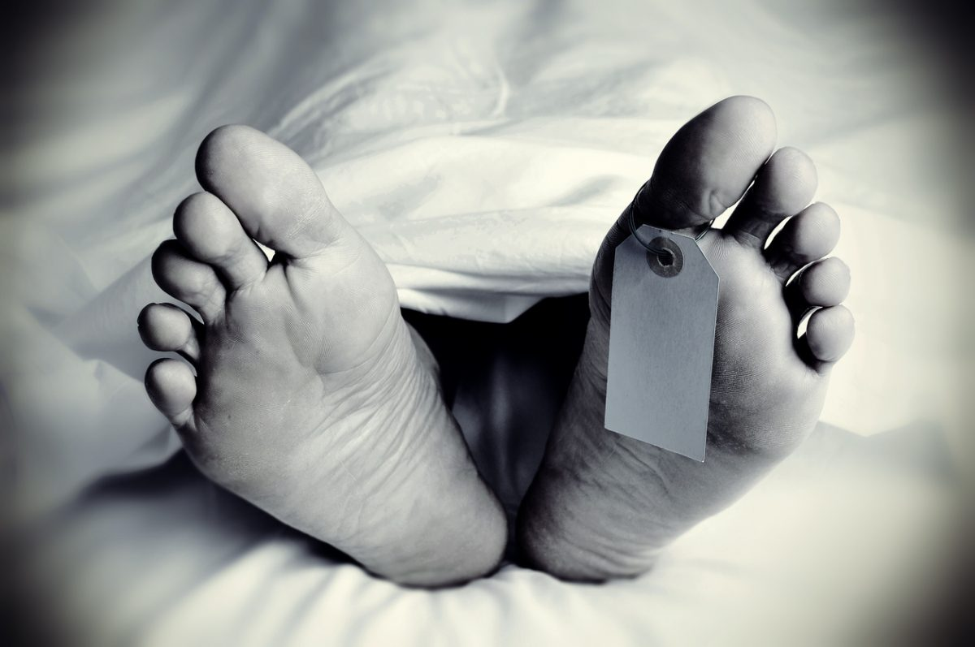
Now Is the Time
Death can come in an instant too.
A breath is all it takes for life to give way to death.
One second there is breath, the next there is none.
You can sit by a myriad of deathbeds, and even if it takes time for them to pass, it is the same.
There is always that instant—now breath, now no breath, the twinkling of an eye.

Slide 26
Obedience
The path from darkness to light starts with obedience, but our transformation takes a lifetime.
If we have obeyed but have not been faithful, now is the time to confess and repent of our sins so we may be forgiven (1 John 1:9).
We read in 2 Peter 3:9 that God is not willing for any to perish.
God does not want to condemn us with sin, and He has sacrificed His Son to allow us to escape His wrath.
Think about what Isaiah 43:25 records: “I, even I, am He who blots out your transgressions, for my own sake; And I will not remember your Sins.”
We must be obedient, faithful and diligent.
If we are not God will punish us for our sins.
It is a fearful thing to fall into the hands of the living God (Heb 10:31).
If we wait too long to obey, in the twinkling of an eye it will be too late.

Slide 27

Discussion
In 2 Peter 3:3-4, do we live in a time of scoffers walking after their own lusts? If yes, illustrate.
What is meant by equating one day with a thousand years in 2 Peter 3:8?
In 2 Peter 3:11, what manner of persons ought Christians to be? What does this look like in or lives?
In 2 Peter 3:12, are we looking for he Lord’s return?

